Slide 1



Presented by Ramesh
Notes:
Welcome everybody
Thanks for joining the today's session, GitHub Copilot
Introduction:
If you have any questions feel free to add them in the chat, or will take up the questions and also, we have Q&A at the end of the session.

Slide 2

Presented by Ramesh
Notes:
Hello! And welcome to GitHub Copilot: the world’s most widely adopted AI developer tool

Slide 3
Agenda
GitHub CoPilot Overview
Upcoming CoPilot Features
GitHub CoPilot Chat
Demo
Working with CoPilot in VSCode
Working with CoPilot Chat
GitHub CoPilot Best Practices
Notes:
This is the today's agenda
So, will be seeing what Copilot offers and how copilot works, and what are the advantages of using copilot using the development environment,
And coming to demonstration we will see, some of the admin level access and polices in the GitHub, and how we can install copilot inside visual studio code.
We will also see the use cases of GitHub Copilot Labs

Slide 4
Agenda
GitHub CoPilot Overview
GitHub CoPilot Chat
Demo
Working with GitHub CoPilot in VSCode
Working with GitHub CoPilot Chat
Q&A
Configuring GitHub Copilot
Codeathon With GitHub Copilot
Notes:
This is the today's agenda
So, will be seeing what Copilot offers and how copilot works, and what are the advantages of using copilot using the development environment,
And coming to demonstration we will see, some of the admin level access and polices in the GitHub, and how we can install copilot inside visual studio code.

Slide 5
Agenda
GitHub CoPilot Overview
GitHub CoPilot Chat
Demo
Working with GitHub CoPilot in VSCode
Working with GitHub CoPilot Chat
Q&A
Notes:
This is the today's agenda
So, will be seeing what Copilot offers and how copilot works, and what are the advantages of using copilot using the development environment,
And coming to demonstration we will see, some of the admin level access and polices in the GitHub, and how we can install copilot inside visual studio code.
We will also see the use cases of GitHub Copilot Labs

Slide 6
Agenda
GitHub CoPilot Overview
GitHub CoPilot Chat
Demo
Working with GitHub CoPilot in IntelliJ / VSCode
Working with GitHub CoPilot Chat
Q&A
Notes:
This is the today's agenda
So, will be seeing what Copilot offers and how copilot works, and what are the advantages of using copilot using the development environment,
And coming to demonstration we will see, some of the admin level access and polices in the GitHub, and how we can install copilot inside visual studio code.
We will also see the use cases of GitHub Copilot Labs

Slide 7



Give your developers a huge advantage
Increase developer productivity
And satisfaction by focusing on real problems
Accelerate innovation
Prototype & innovate more rapidly
Bridge skill gaps
Learn new languages and techniques
Notes:
GitHub Copilot Give Your Developers the Advantage of AI
So, copilot generally aims to increase developer productivity and general reduce developer time by reducing disruptions , and improving flow and increasing the amount of time a developer spends doing satisfying work.
----So when we talk about the----
Increase developer productivity and satisfaction: Copilot will supports developers by helping them focus on solving real problems. By providing suggestions, boiler-plate code, developers can cut down on development time and create more consistent code. And also Adopting GitHub Copilot has also has secondary advantages, where it can improving job satisfaction with your developer support.
And copilot will help you Accelerate Innovation: so, we need to put it as new ideas create any new work concepts for specific functionality
Using Copilot, teams can prototype new ideas more rapidly and innovate faster. As an additional benefit, companies that adopt the latest technologies can attract new talent by investing in the best-in-class tools as they seek to modernize their development processes.
So, copilot also aims to Bridge your skill gaps: so, any new professionals who were new to leaning any platform or any language with the help of
Copilot these professionals will be train quicker and their will be a practice for new languages much faster. GitHub Copilot can help companies to train the new employees with those skills faster.

Slide 8

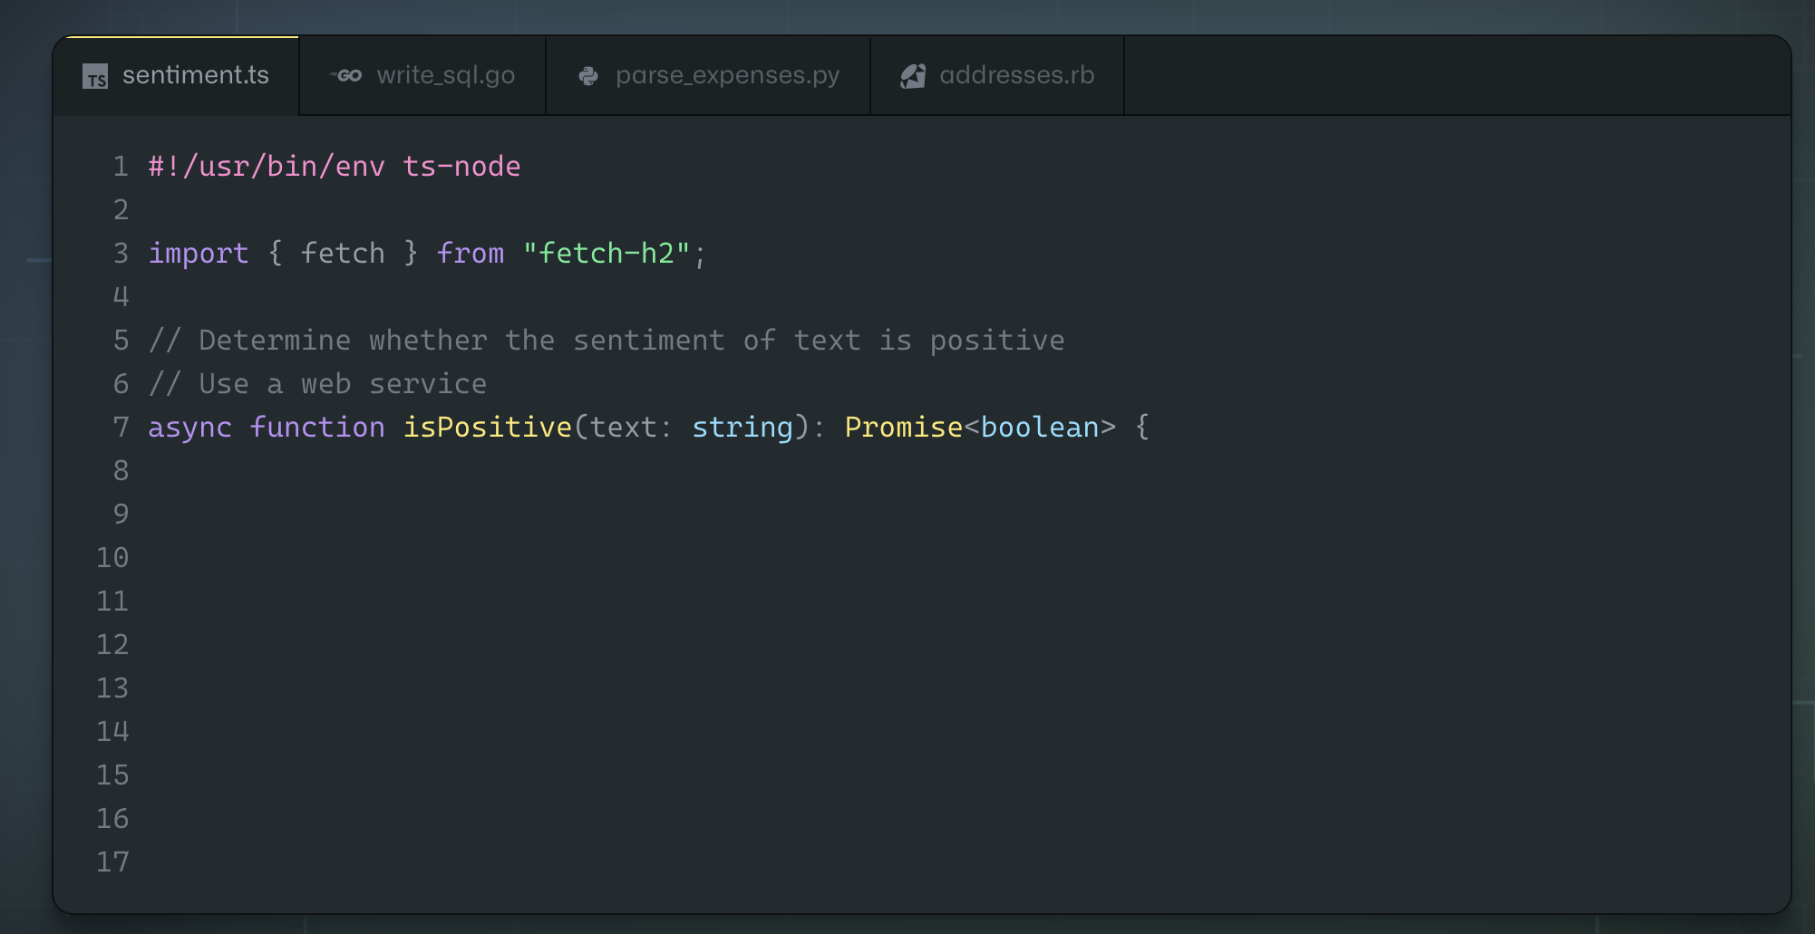
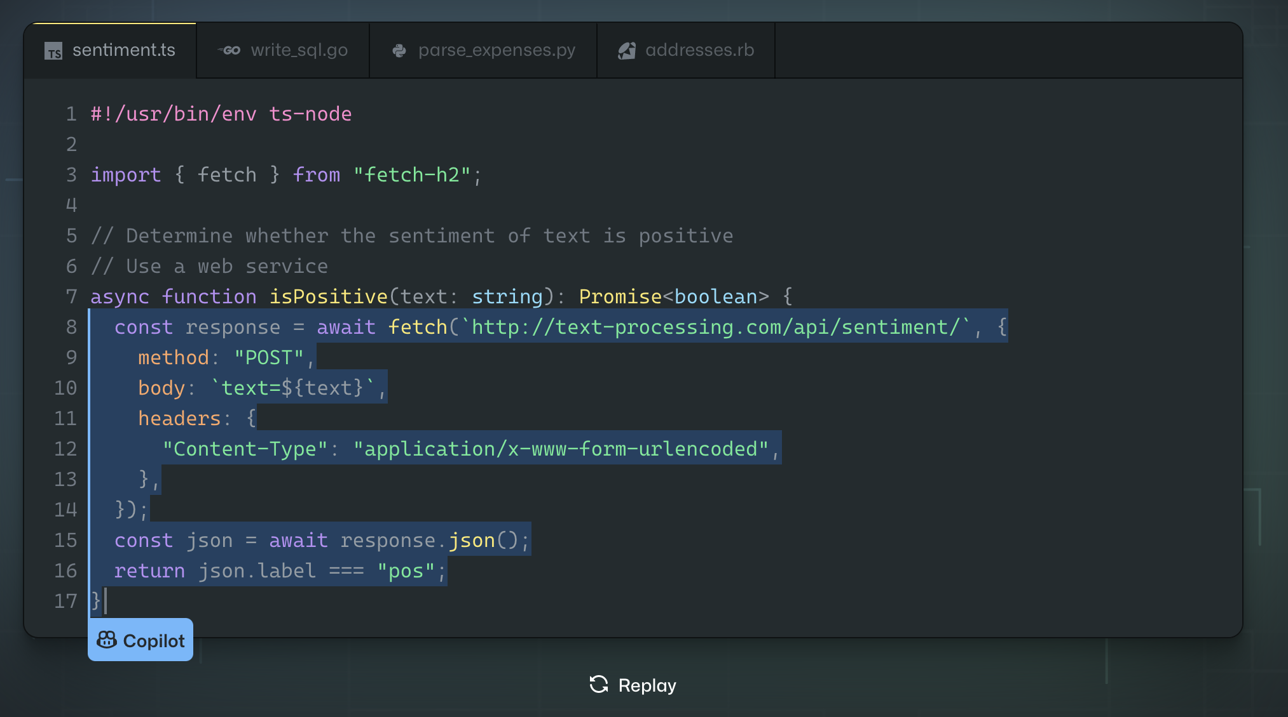
96%
88%
74%
say they are faster with repetitive tasks
say they are more productive
focus on more satisfying work
Notes:
So, these are some of the survey no.s which were conducted by the GitHub with more than 2000 developers how their experience after using the copilot and some of the observations with efficiency and flow, how faster they are with repetitive tasks.
96% much more faster with repetitive tasks.
And with productivity 88% say they are more productive
And coming to satisfaction 74% focus on more relevant work.

Slide 9
Developers using GitHub Copilot…
88%
…have faster completion
87%
…exert less mental effort on repetitive tasks
77%
…spend less time searching
73%
…stay more in the flow
60%
…are more fulfilled with [their] job
59%
…are less frustrated when coding
Notes:
Here’s some more details from our findings with respective developers using GitHub copilot from our research.
The first four are from the Efficiency and Flow section
88% have faster completion of tasks
87% has face less mental effort on repetitive tasks
77% have spend less time on searching for the best code.
and more than 70% stay more in the flow.
And the last two are from the Satisfaction and Well-being section.
Like 60% are more happy to fulfilled their job
And 59% are less frustrated when coding by using the GitHub copilot.

Slide 10
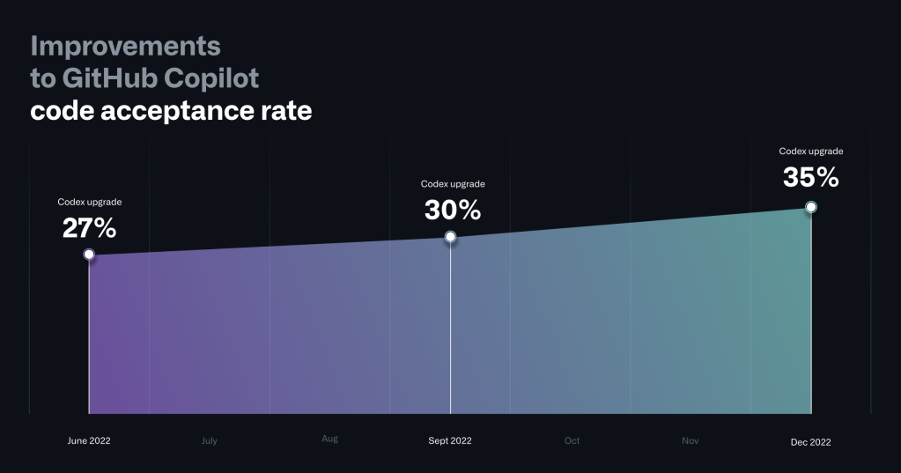
Developers using GitHub Copilot…
88%
…have faster completion
87%
…exert less mental effort on repetitive tasks
77%
…spend less time searching
73%
…stay more in the flow
60%
…are more fulfilled with [their] job
59%
…are less frustrated when coding
Notes:
To improve the quality of GitHub Copilot’s code suggestions, we have updated the underlying Codex model resulting in large scale improvements to the quality of code suggestions and reduction of time to serve those suggestions to the users.
Case in point: When we first launched GitHub Copilot for Individuals in June 2022, more than 27% of developers’ code files on average were generated by GitHub Copilot. Today, GitHub Copilot is behind an average of 46% of a developers’ code across all programming languages—and in Java, that number jumps to 61%.
Here are the key technical improvements we made to achieve this:
An upgraded AI Codex model: We upgraded GitHub Copilot to a new OpenAI Codex model, which delivers better results for code synthesis.
Better context understanding: We improved GitHub Copilot by a new paradigm called Fill-In-the-Middle (FIM)—which offers developers better craft prompts for code suggestions. Instead of only considering the prefix of the code, it also leverages known code suffixes and leaves a gap in the middle for GitHub Copilot to fill. This way, it now has more context about your intended code and how it should align with the rest of your program. FIM in GitHub Copilot consistently produces higher quality code suggestions, and we’ve developed various strategies to deliver it without any added latency.
A lightweight client-side model: We updated the GitHub Copilot extension for VS Code with a lightweight client-side model that improved overall acceptance rates for code suggestions. To do this, GitHub Copilot now uses basic information about the user’s context—for example, whether the last suggestion was accepted—to reduce the frequency of unwanted suggestions when they might prove disruptive to a developer’s workflow. This resulted in a 4.5% reduction in unwanted suggestions, helping GitHub Copilot better respond to each developer using it. And with a second, improved iteration of this client-side model that we shipped in January 2023, we’ve seen even better improvements in overall code acceptance rates.

Slide 11


GitHub Copilot / AI-Powered SDLC
An extension for the world’s most popular code editors.
From the IDE and Terminal
To the Platform
Notes:
GitHub Copilot doesn’t just stop at the IDE. Plan for Copilot AI-assistance for developers throughout their entire workflow in the entire software development lifecycle. That means Copilot in the command-line interface and Copilot built into the GitHub Enterprise platform.
-----
So, lets start with the details of what copilot is and how we can use copilot today *
So, github copilot can be installed as an extension in VScode, Visual Strudio, all Jetbrains IDE’s, and Neovim editor as well..
Eclipse is not yet supported, it is in the road map as of today. You can use VScode or Intellji for any java applications.

Slide 12
Offers code suggestions, contextualised to your project
Convert comments to code
Autofill for repetitive code
Show alternatives
Notes:
----
So, what essentially copilot does right?
So, copilot offers code suggestions which are contextualise to your project.
So, any inputs which you have added in your current file, any files which might have been opened.
So, copilot would be able to build the context from the current inputs from your file. It even takes your file name, file extension that will be consider as part of context.
So, that context can include any comments which might you added inside your respective file and that can be converted into the code.
So, copilot will also help a lot in providing suggestions for any repetitive code pattern or quickly produces boilerplate code, and also it will give you multi suggestions window where you can accept any one suggestion as per your needs.
------

Slide 13
It can be a question, statement, or a description of what you want Copilot to do
Accepted in the form of comments in your file or inputs in Copilot Chat
What does Copilot interpret as a prompt?
Notes:
If you’ve used generative AI tools, such as ChatGPT, you may be unaware that you’re already familiar with what prompts are and some of the capabilities available to you.
-------
So, when we talk about creating a suggestions right?
Here you need to provide a prompt, it can be a comment or a question or a statement, or a description,
Or a logic what you would need to implement,
So, these all are considered as a prompt which can be used inside your copilot and copilot chat.

Slide 14

Pillars of effective Copilot prompts
Context
Intent
Clarity
Specificity
Information provided in the prompt that helps Copilot understand the task better.
The specific goal or purpose you have in mind when creating a prompt.
The quality of being unambiguous and easy to understand.
The level of detail and precision in a prompt.
Notes:
Here to make sure to write the effective prompts.. To get the more targeted suggestions,
we recommend all to use and remember these 4 pillars to provide the effective prompts..
Context: Context is the information which GitHub copilot has to make sure that you are getting the right suggestion.
So, context can be your current file or if you were referencing to other files those files also needs to be open inside your ide. And any inputs or prompts which you are providing all will be considered as context to provide you the necessary suggestions.
Context: Without context, Copilot will return suggestions that aren’t as tailored to your requirements as they could be
Intent: Identify the end goal, you will need to specify inside your promt itself like what you are looking to achive
For example “I need to create a calculator class that will calculate sin, cos, and tan”.
This establishes our intent that Copilot should return a code suggestion that creates the calculator class with your specific functions.
Clarity: Avoid ambiguous language when writing prompts so you reduce the risk of Copilot misinterpreting what it is you want.
Specificity: Prompts that include specifics to take into account help GitHub Copilot generate more relevant and accurate responses. For example, if I want to Copilot to return a suggestion that uses a specific library, it helps to indicate the specific version you want to use. The same would apply when defining a function and telling Copilot the different edge cases and data types to use.

Slide 15
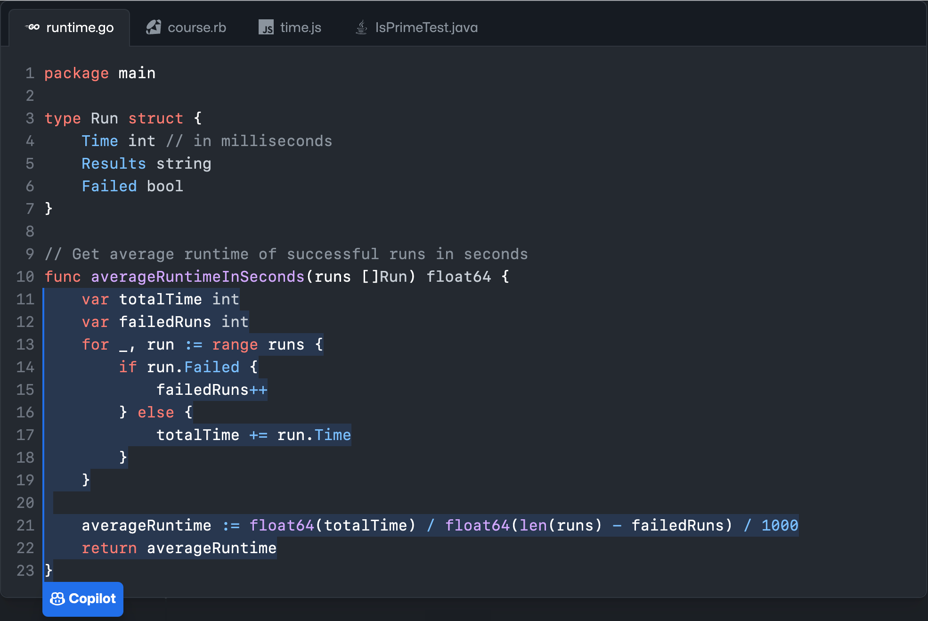

Once enabled…
Context
Suggestions
OpenAI Codex
Notes:
So, lets see in detail about how copilot will work on back end
Basically, Copilot is trained on all languages that appear in public. And also, the suggestion strength is robust and great for popular languages.
but the strength will vary based on which language is used most or least by the users in the current software development lifecycle.
For Example, java SCRIPT is the most popular one, of GitHub Copilot’s popular languages.
Languages with less representation in public repositories may produce fewer or less robust suggestions.
Once you enable the copilot in your code editor.
Based on your inputs what your editor with the copilot extension start providing the context to copilot.
GitHub Copilot uses the OpenAI Codex Model and GPT-3 behind the scenes.
Based on open AI codex It returns suggestions those suggestions were return to your editor where you choose what to accept or what to ignore for that particular suggestion.
GitHub Copilot also provides context from local files. It’s not attached to a repository. The file which you are being edited could be hosted on GitHub or in any other repo, so it’s not a requirement.
So, even if you're working with different source control tool, you can still use copilot to work with your code and push to your repo.
But definitely need GitHub to validate the GitHub copilot license.
And also, any data sharing for copilot will happen in an ephemeral way. It’s shared just long enough for the codex to found to provide a suggestion which GitHub copilot will provide the suggestion to your editor. So, any where that code is not taken, or it not put into the codex model for any suggestions. So, the data will not store anywhere outside your repositories or your development machines
GitHub Copilot uses a transformative model. Think of something like Google Translate. So, when you use Google translate You put in some words in English, translate it into another language. Google Translate hasn’t seen that exact sentence before necessarily and translated into that new language. So, how it does that is, Google Translate understands the semantics; the definition of the words, language patterns, whether this sentence is a subject or direct object, and based upon that input, it will suggest an appropriate result. You could think about GitHub Copilot as a translation tool.
GitHub Copilot will write novel code. But having said that, GitHub Copilot is looking for language patterns and it learns language patterns.
There may be a few times where a particular line, or a few lines of code, appears in thousands and thousands of repositories. That starts to look like a language pattern, rather than its own unique piece of code. So, In those cases, GitHub Copilot will occasionally will give you suggestions, what it thinks is a pattern as it’s seen it so many times. For that case, the GitHub Copilot team created an IP filter. So, using this filter you can restrict the code suggestions matching public code on GitHub. So, You can choose to enable or disable the filter. When the filter is enabled, Copilot checks code suggestions with their surrounding code of up to 150 characters against any public code on GitHub and If there is a match or near match, the suggestion will not be shown to you. This is done on the Service side of GitHub Copilot,

Slide 16


Data flow
IDE Workspace
GitHub owned Azure tenant
Copilot Proxy Service
IDE Plugin
Authenticate
Sentiment analysis (Abusive language etc)
Security filter
Basic PII filter
Sentiment analysis
Duplicate detection OSS filter
Context (Prompt)
OpenAI LLM
Suggestions
Notes:
So, now will see how the copilot will work on back end?
For example, let take this is your editor, and you added some inputs, and you have opened some other files, which will be referencing that opened files.
So, especially here the context will be built on your current inputs from your current file and that context on your code will go through the Copilot proxy service.
So, that context will goes through proxy service where it will goes through the Open ALLLM model to provide you suggestions.
As soon as the suggestions are provided in your editor, immediately the context based on your code from the open AI LLM model will be immediately discarded.
So, as when the suggestions are coming to your editor from open AI, it will check the security filter where it will check and see any vulnerabilities it will automatically blocks or discard the suggestions which match any vulnerable pattern’s,
the vulnerable patterns can be like SQL injections, So, this kind of vulnerable patterns can be automatically checked, and those suggestions were automatically discarded.
And your PII filter where it will be identified any personal identifier, like IP address, or any hardcoded credentials all these will be automatically discarded before it coming to your editor.
It will scan another sentiment analysis to make sure you will get only the suggestions match your requirements,
And also, we have duplicate detection filter, duplicate detection filter is something which would have to enable by your GitHub enterprise admin.
So, what this will do *, this will make sure that you won't get any code suggestions which match exactly or near matches the public code.
Generally what copilot generate the code where it is unique and owned by the developer and the organization.
In certain cases, if the particular prompt is a very generic prompt and the suggestion where it provided.. to match the exact match of public repos.
So, to avoid those kind of situations. GitHub provides you the filter where GitHub admin can enable, and which will block those kind of suggestions.
After it goes to all these filters the suggestions were then goes back to your IDED.
This is how copilot works on backend….

Slide 17
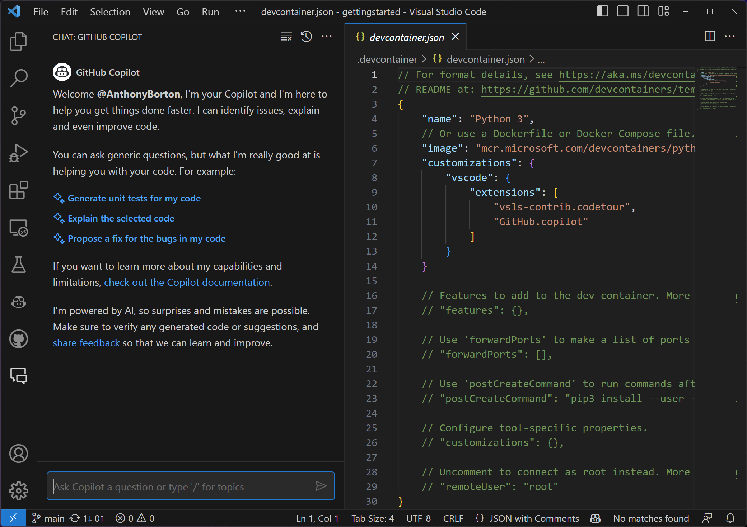
Copilot Chat
Context-aware ChatGPT-styled conversations with Copilot
Slash commands (Workspace agent)
/explain
Explains how the selected code works
/fix
Proposes a fix for the problems in the selected code
/new
Create a new project based on a natural language description
/newNotebook
Create a new Jupyter Notebook based on your description
/terminal
Explain how to do something in the integrated terminal
/tests
Generate unit tests for the selected code
Slash commands (vscode agent)
/api
Questions about VS Code extension development
Slash commands
/clear
Clear the session
/help
General help about GitHub Copilot
Notes:
To further help Copilot give you more relevant answers, you can indicate the scope and intent of your question through agents and slash commands.
Agents are like experts who have a specialty that they can help you with, and you can talk to them in the chat by mentioning them with the @ symbol. Currently, there are two agents:
@workspace has context about the code in your workspace and can help you navigate it, finding relevant files or classes.
@vscode knows about commands and features in the VS Code editor itself, and can help you use them.

Slide 18
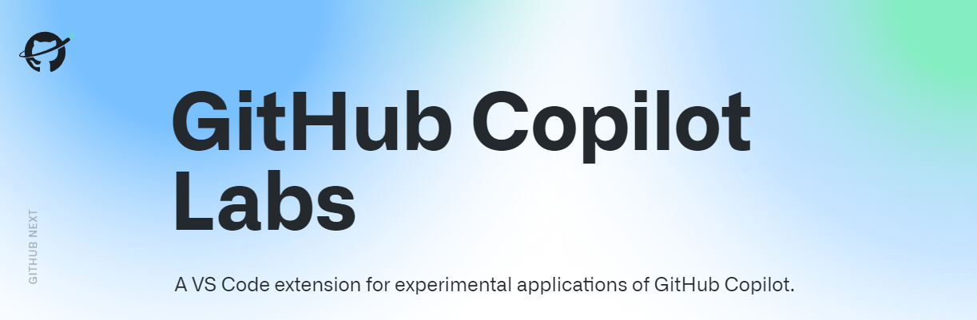

Slide 19

GitHub Copilot Labs
Current Copilot Labs Features:
• Code explanation
• Code translation
• IDE Brushes
• Test generation

Slide 20
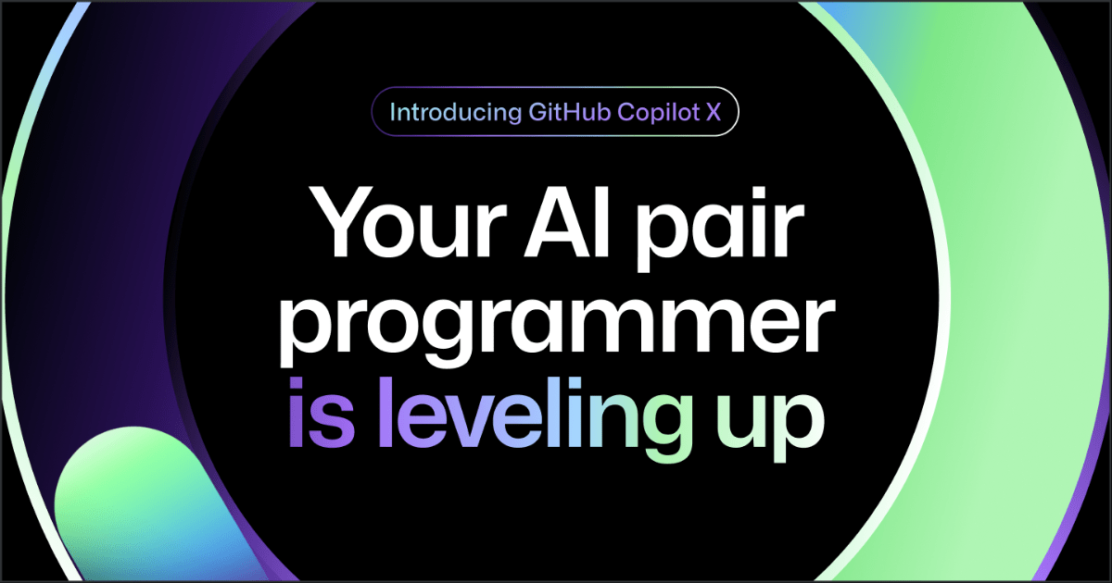
Notes:
GitHub Copilot X uses the Open AI GPT-4 and it is the future of AI powered software development integrated into every part of your workflows,
Like with chat and terminal interfaces, and also support for pull requests as well.
Still it has not been released to the public yet. But A waitlist is available for this feature.

Slide 21

GitHub Copilot X
the future of AI-powered software development
“With chat and terminal interfaces, support for pull requests, and early adoption of OpenAI’s GPT-4, GitHub Copilot X is our vision for the future of AI-powered software development. Integrated into every part of your workflow.”
Join the wait-list: https://gh.io/copilotx
Notes:
https://github.com/features/preview/copilot-x

Slide 22
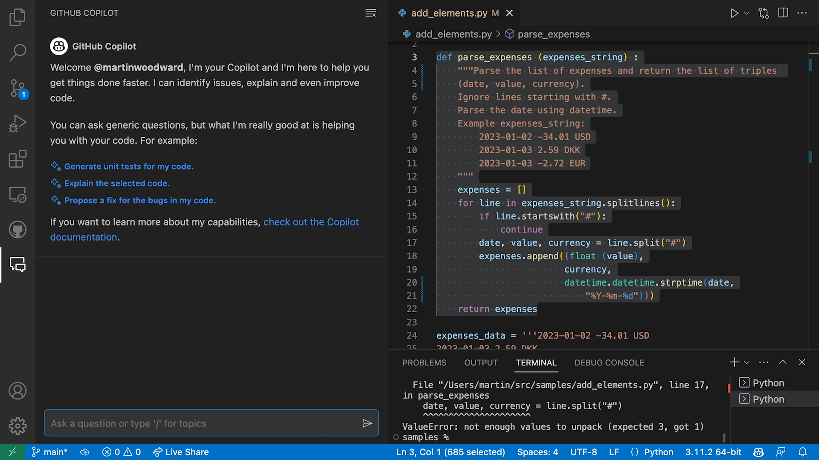
GitHub Copilot Chat
Chat experience in the IDE
ChatGPT-like experience in editor
Generic questions
Generate unit tests
Explain the code
Propose a fix for bug
Make code robust / secure
Support VS Code and Visual Studio
Voice-to-code with GitHub Copilot Voice

Slide 23
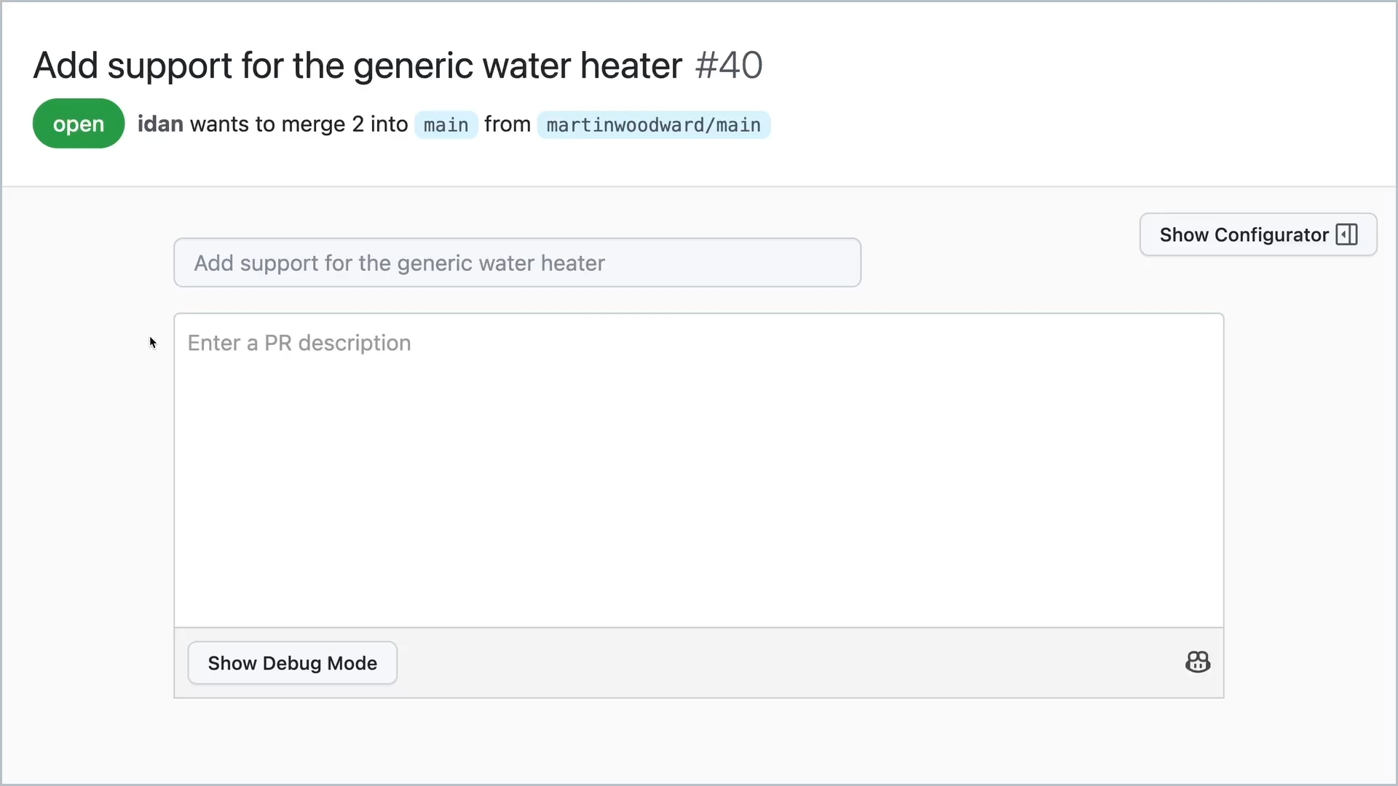
Copilot for Pull Requests
the future of AI-powered software development
AI powered tags in Pull Requests
Automatically suggest sentences and paragraphs as developers type based on PR code changes
Automatically warn and suggest tests where needed

Slide 24
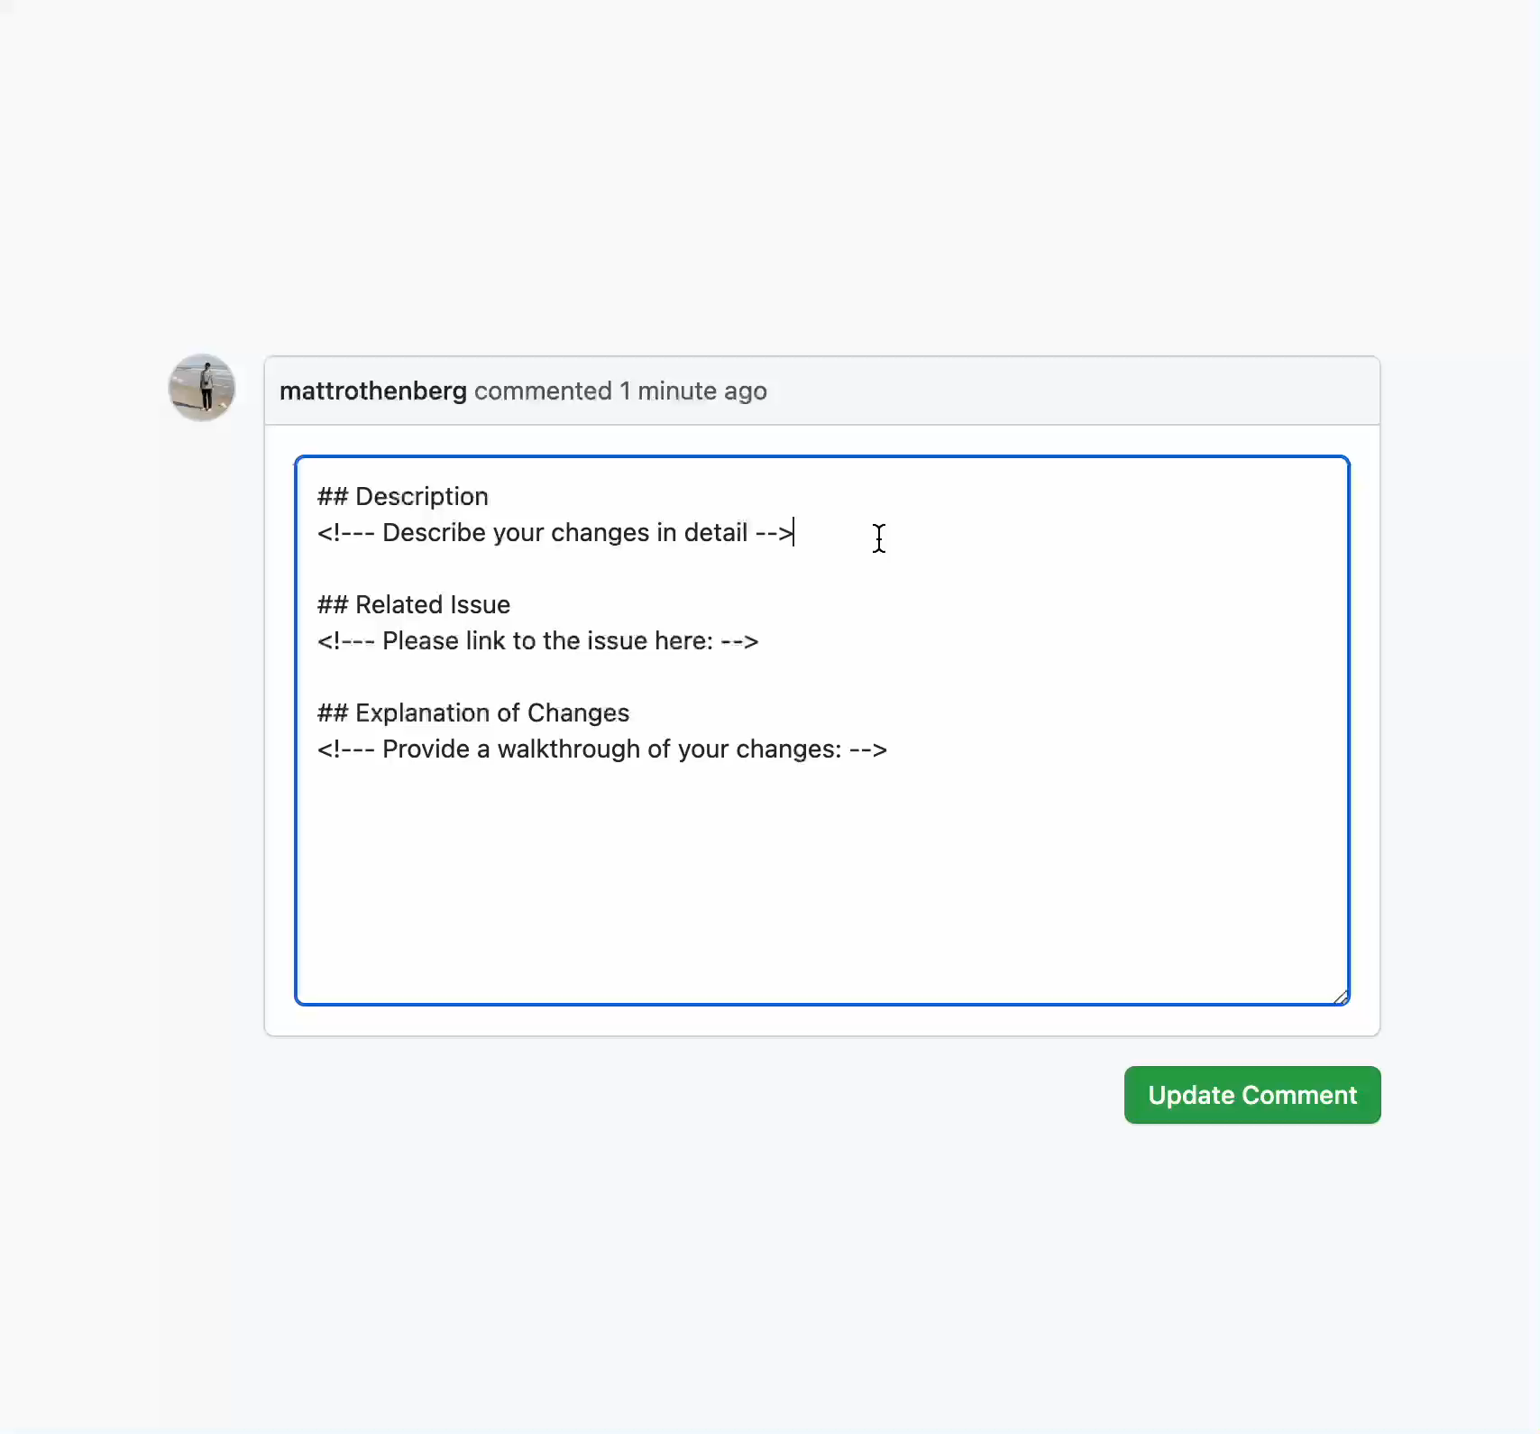
CoPilot For GitHub PRs
AI-generated PR descriptions. We've all skipped the pull request template one too many times. No more. TAB TAB TAB Submit And, you're done!
Automate automated testing. Missed a test? GitHub Copilot can point out missing unit tests and generate new test cases for you after every build.

Slide 25
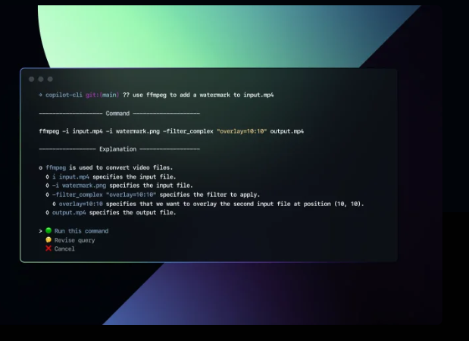
CoPilot CLI
Ask GitHub Copilot for assistance right in your terminal. Need help with multi-step shell commands and scripting? Just explain what you want to do.
Notes:
Forget how to delete a tag? Ask GitHub Copilot for assistance right in your terminal. Need help with multi-step shell commands and scripting? Just explain what you want to do

Slide 26
Let’s demo!

Slide 27

2
Analysis
1
Planning
3
Design
GitHub Copilot tomorrow Refactoring code (code translate) Reviewing code (code explain) Documentation
6
Maintenance
4
Implementation
GitHub Copilot today Convert comments to code
Autofill for repetitive code
Show alternatives
5
Testing & Integration
GitHub Copilot tomorrow Unit testing Finding code errors Debugging Code review
AI Pull Requests
Notes:
We continue to explore how GitHub Copilot and AI can help developers stay in the flow throughout the entire SDLC.

Slide 28
Get the advantages of AI today
Increase developer productivity
And satisfaction by focusing on real problems
Accelerate innovation
Prototype & innovate more rapidly
Bridge skill gaps
Learn new languages and techniques
Notes:
Repeat earlier talking points as a call to action. Tweak message based on audience.

Slide 31


